Slide 1
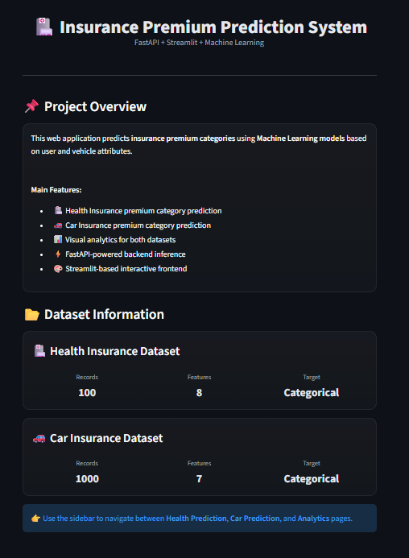
Insurance Premium Prediction Web Application
A Full-Stack Web Application Integrating Machine Learning
WEB DEVELOPMENT
STREAMLIT + FASTAPI

Slide 2
Problem Solved by this Project
Insurance Decision Support Challenge
Insurance providers and customers need quick, accurate premium estimates. Manual assessment is slow and inconsistent. Our web application automates this process through a modern client-server architecture and ML Model.
Instant premium category predictions
Standardized evaluation criteria
User-friendly web interface
Separate modules for health and car insurance

Slide 3


System Architecture
User Browser (Streamlit)
Interactive frontend UI
Predictions Returned
Three-tier Web Architecture
HTTP Requests
RESTful API calls to backend
Results sent back to user
ML Model Processing
FastAPI Backend
Data inference and transformation
Handles business logic
This application follows a modern client-server architecture. The Streamlit frontend provides an intuitive multi-page interface, communicating with a FastAPI backend via RESTful API calls. The backend handles business logic, data processing, and ML-powered predictions.

Slide 4
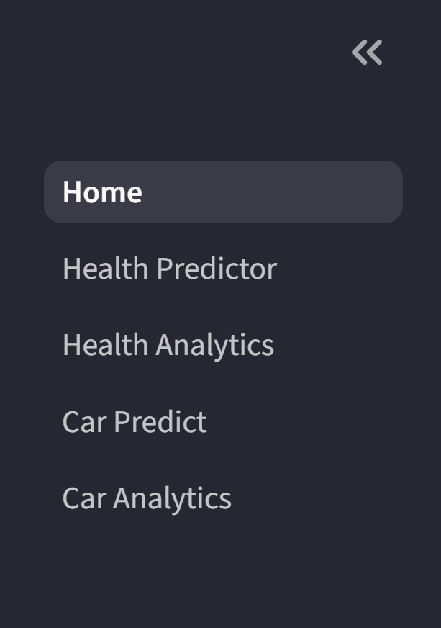
Frontend Design with Streamlit - Navigation Bar
Multi-Page Navigation
Interactive Forms
Responsive Design
Intuitive sidebar for modules like health, car, analytics.
Dynamic validation using sliders, dropdowns, number fields.
Clean, dark-theme interface, adapts to all screen sizes.

Slide 5

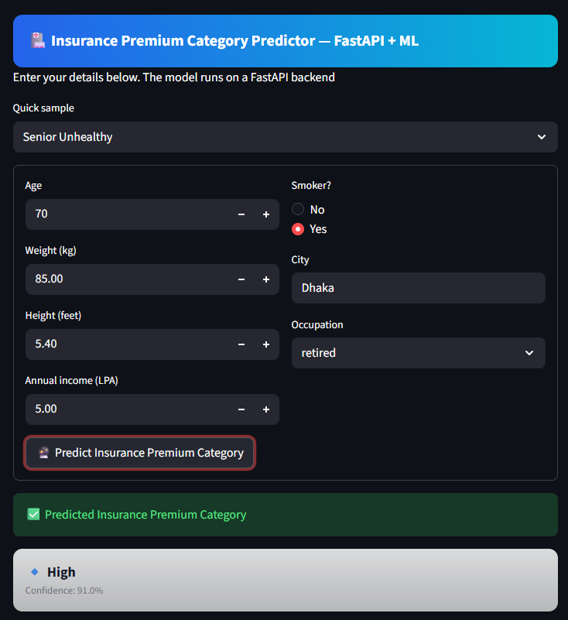
Health Insurance Prediction and Results
Interactive form interface for collecting health insurance applicant data with real-time validation and user-friendly input controls.
Features:
Simple form for health and lifestyle details
Automatic premium category prediction Using ML Model
Output: Low / Medium / High Category of Users for Insurance.
Usability:
Easy to use input fields
Instant result after submission
Suitable for general users

Slide 6
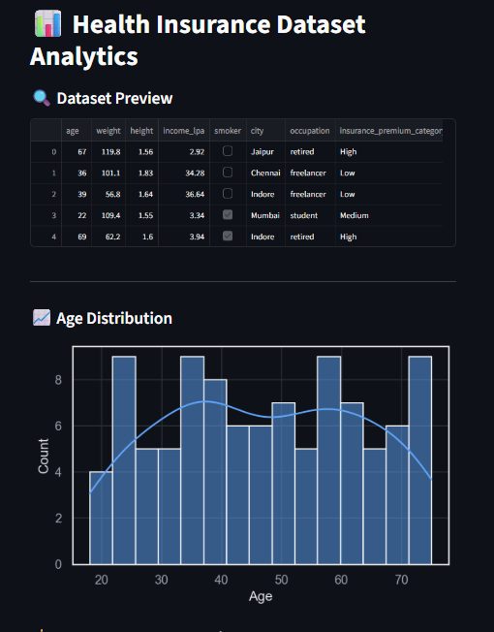
Health Insurance Prediction Dataset and Distributions.
Dataset Displays an overview of the health insurance dataset
It shows how user age is distributed across the dataset and Helps understand the diversity of user profiles Which is Useful for validating data before prediction
Age distribution shows balanced coverage across age groups, allowing the model to generalize well.

Slide 7
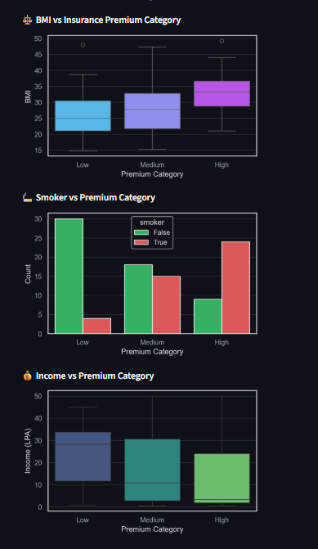
Health Insurance Dataset Features Analytics
BMI vs Premium Category shows that higher BMI values are more common in the High premium group, indicating increased health risk.
Smoker vs Premium Category highlights smoking as a major risk factor, with smokers dominating higher premium categories.
Income vs Premium Category suggests that premium categories are not solely income-based but strongly influenced by health conditions.

Slide 8
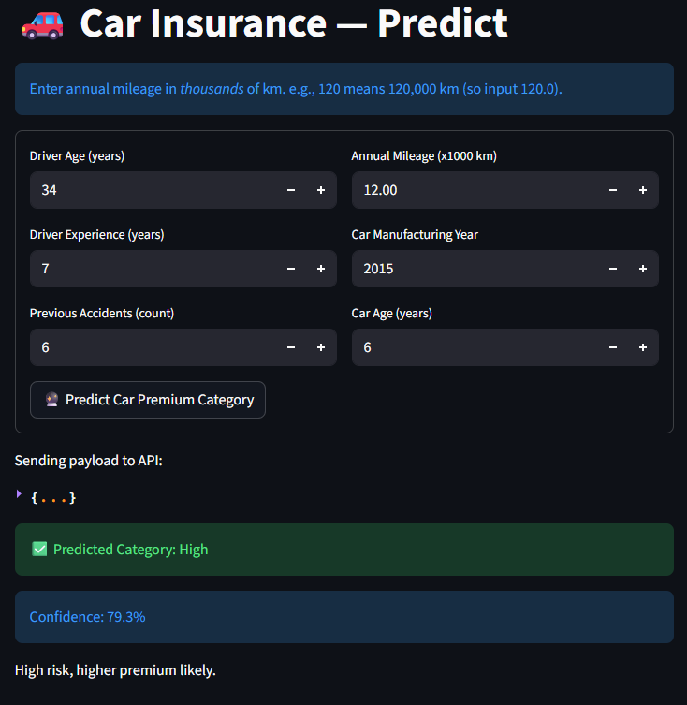
Car Insurance Prediction Form
Interactive form interface for collecting Car insurance applicant data with real-time validation and user-friendly input controls.
Features:
Inputs based on car insurance dataset
Direct premium category prediction
Output: Low / Medium / High Category of Car for insurance
Usability:
Minimal and relevant inputs only
Quick and clear prediction result
Helps estimate insurance risk easily

Slide 9
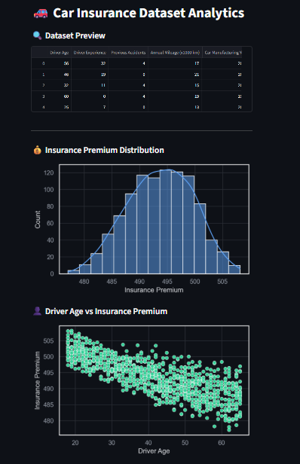
Car Insurance Prediction Dataset and Distributions.
This section provides an overview of the car insurance dataset structure and premium distribution.
Dataset includes key attributes such as driver age, experience, accident history, mileage, and car age.
Insurance premium Distribution values follow a near-normal distribution, making them suitable for predictive modeling.
Driver Age Vs Target Chart Shows A visible trend shows that younger drivers often pay higher premiums, while experienced drivers tend to have lower costs.

Slide 10
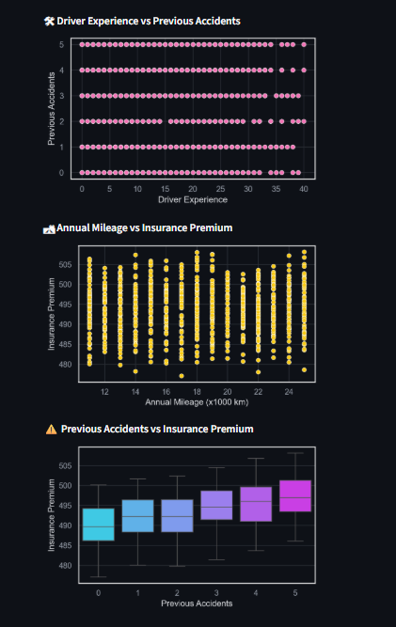
Car Insurance Dataset Features Analytics
This section analyzes how different driver and vehicle-related features influence car insurance premiums.
Driver Experience vs Previous Accidents Less experienced drivers tend to have a higher number of previous accidents, indicating higher risk.
Annual Mileage vs Insurance Premium Higher annual mileage generally leads to increased insurance premiums due to greater exposure to road risk.
Previous Accidents vs Insurance Premium Insurance premium clearly increases as the number of previous accidents rises, showing strong risk-based pricing.

Slide 11
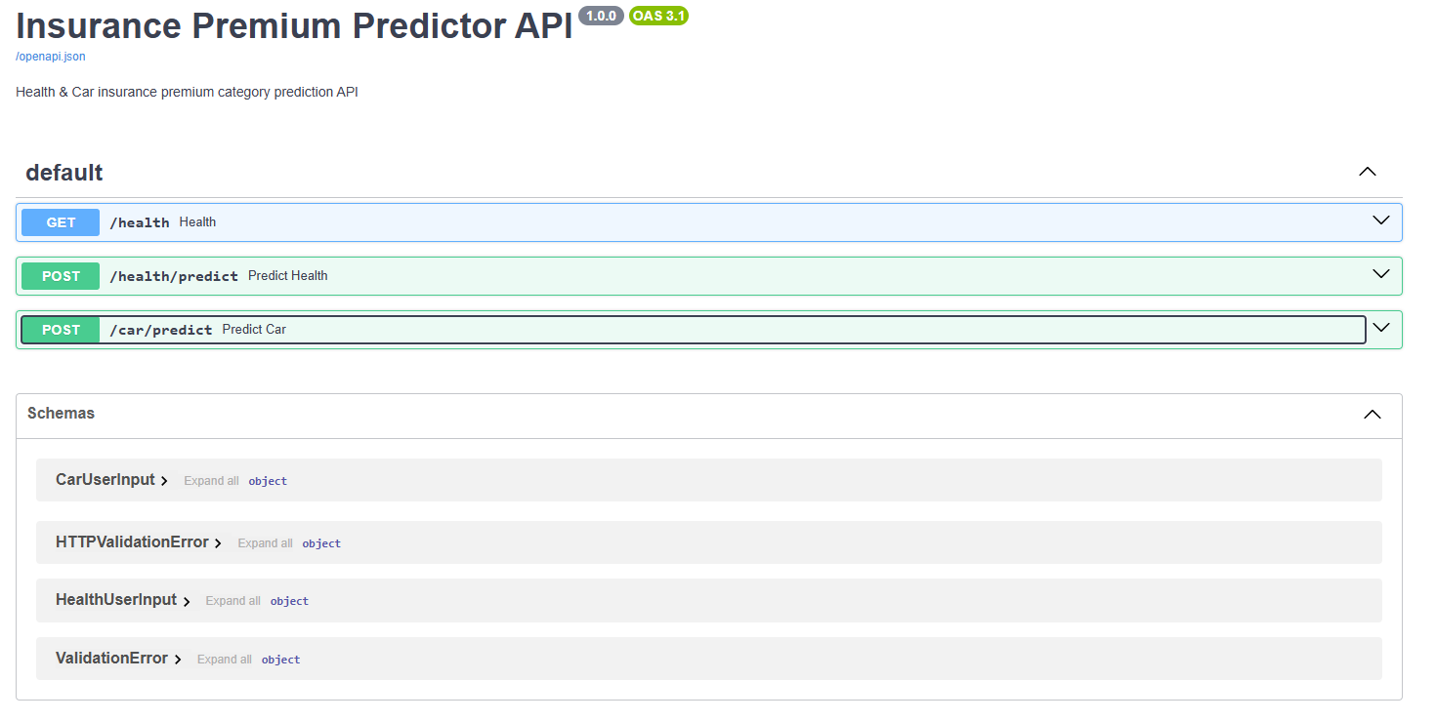
FastAPI Documentation
FastApi Provides Built-in Documentation Using Swagger UI. Here is the Interactive API documentation with request and response examples for all prediction endpoints.

Slide 12
Backend API Design
FastAPI Endpoints
The backend exposes RESTful API endpoints for prediction and health checks:
/predict/health - Health insurance premium prediction
/predict/car - Car insurance premium prediction
/health - API health check endpoint
Endpoints accept JSON payloads, validate input, apply business logic, and return structured prediction results.

Slide 13
Data Handling & Business Logic
Health Insurance Processing
Accepts demographic data and lifestyle factors. Backend computes BMI from height/weight, determines age groups, and evaluates risk levels based on smoking status and occupation.
Car Insurance Processing
Processes driver and vehicle characteristics including experience level, accident history, annual mileage, and car age to assess risk factors comprehensively.

Slide 14




Prediction Workflow
User Input
API Request
Customer fills web form with insurance details
Frontend sends HTTP POST to FastAPI backend
ML Prediction
Result Display
scikit-learn model processes features and predicts category
Premium category shown on web interface
The entire request-response cycle completes in under one second, providing real-time feedback to users.

Slide 15
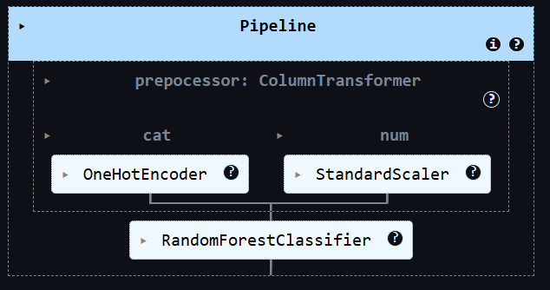
Machine Learning Algorithms
And preprocessing
ML Model:
Random Forest Classifier Used for predicting insurance premium categories
Suitable for handling mixed input features
Provides stable and accurate classification results
ML Workflow Includes:
Dataset loading and cleaning
Feature selection and preparation
Data preprocessing using pipelines (scaling & encoding)
Model training and evaluation
Model integration with FastAPI backend

Slide 16
Application Modules Demo
Health Insurance Module
Inputs: Age (25-70), Weight (kg), Height (cm), Annual Income, Smoker Status (Yes/No), City Type (Urban/Rural), Occupation Category
1
Derived Values: BMI calculation, Risk level assessment, Age group classification
Output: Premium Category with confidence score
Car Insurance Module
Inputs: Driver Age, Years of Driving Experience, Number of Previous Accidents, Annual Mileage (×1000 km), Car Manufacturing Year, Car Age (years)
2
Processing: Risk factor calculation based on driver history and vehicle condition
Output: Premium Category recommendation

Slide 17

Conclusion & Future Enhancements
Project achievments
Future Web Improvements
Future ML Improvements
Use larger and More diverse datasets
Improve feature selection and risk scoring Logic
Add Model performance monitoring
Enable periodic model training with new data.
Successfully built a production ready web application demonstrating modern full-stack development practices with clean separation of concerns.
User authentication and session management
Database integration for prediction history
Real-time WebSocket updates
Mobile-responsive progressive web app
A/B testing framework for UI variations

